Slide 1
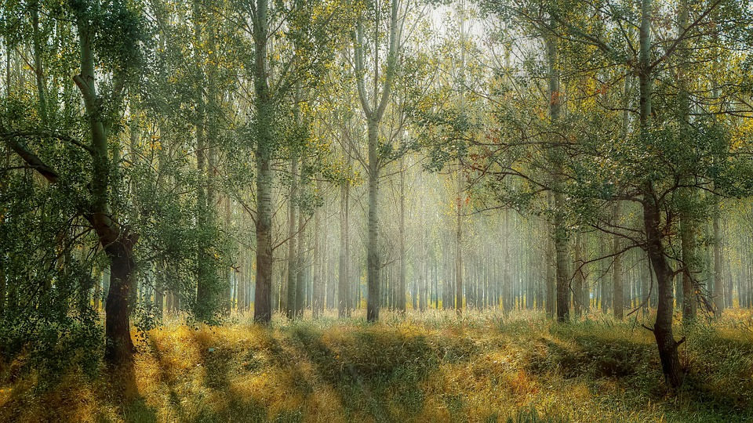
In 2010 ,Cambodia of natural forest

Slide 2
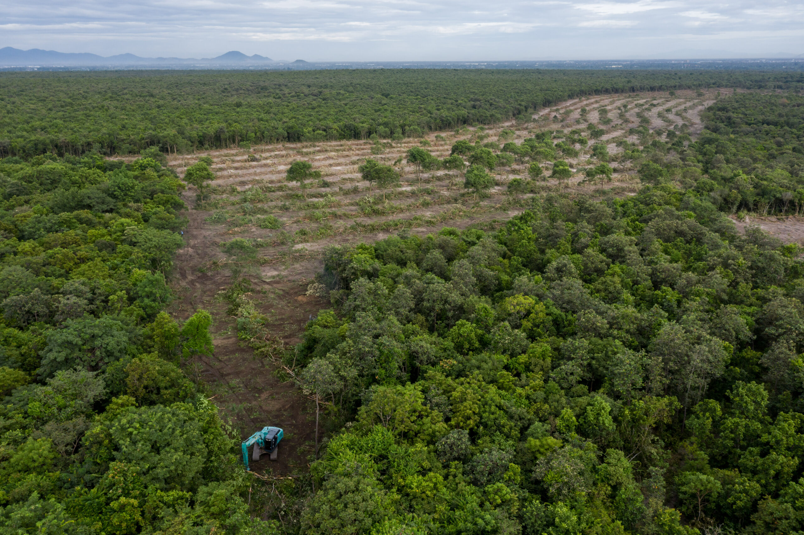
In 2021, it lost 141kha of natural forest, equivalent to 83.2mt of co emissions

